Slide 1

StockWatch
Chenson Johnson, Binju Shrestha, Samuel Khalil, David Osterhoff, Yunfan Yang, Zheng Zeng, Zhuoming Lei

Slide 2
Overview Sprint 2
For sprint 2 we are focusing on implementing the authentication system
We will present our backlog of work and the user stories for the authentication system
We will also present quality assurance tests for the authentication system as well as the interface

Slide 3
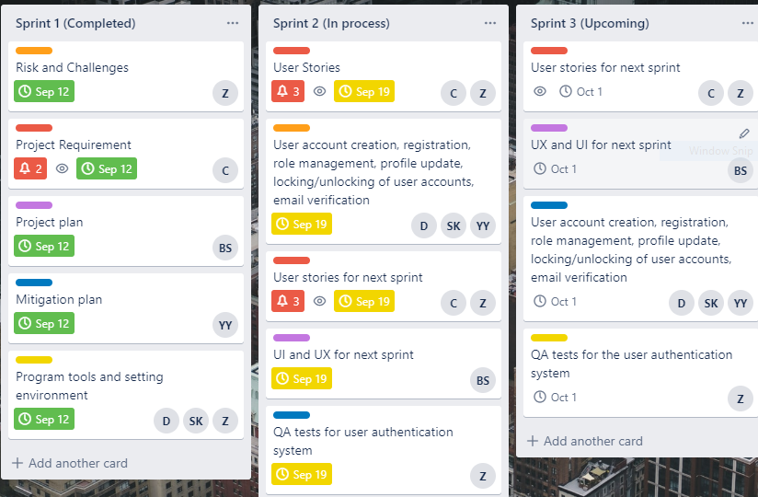
Backlog

Slide 4
User Login/Authentication
Included in Flask
Stores passwords in secure database
(uses SQLAlchemy)
Allow users to keep personalized lists of stocks to track

Slide 5
User Stories
User Account Creation
US# | Role | Action | Goal
1 | Unregistered User | As a first-time user I want to be able to register on the website | Secure My Account
2 | Unregistered User | As a first-time user I want to have a unique user name | Customize Account
3 | Unregistered user | As a first-time user I want to have a secure password | Secure My Account
4 | Registered User | As a user I want to be able to access my account at anytime | Availability

Slide 6
User Stories
ROLE MANAGEMENT
US# | Role | Action | Goal
31 | Administration | As the admin I want to access the database so that I can view all current emails | Participate in communication for registered users
32 | Administration | As the admin I want site wide access | So, I can manually resolve any issues
33 | Administration | As the admin I want to access the database | To delete, update user’s information
34 | Administration | As the admin I want to create other administrators | So, I can delegate task

Slide 7
User Stories
Email Verification
US# | Role | Action | Goal
21 | Registered User | As a registered user I want to verify my email address | Provide ways to be contacted
22 | Registered User | As a registered user I want to be able to submit feedback | Contact the application owners

Slide 8

Quality Assurance Testing

Slide 9
Functionality Testing
Since the front end of our project will be HTML base the first system testing that we will do is functionality testing to make sure that the website works as specified. We will test the following:

Slide 10

Outgoing Links that directs to another webpage
Internal Links that can allow navigation from one page in a website to another
Anchor Links to make navigating easier
Mail to Links
Check to make sure default values are being populated
Forms are clearly formatted and readable
Checking to make sure the right error message is shown.
Test Forms

Slide 11
at the rest of time
We also want to test the html and css of the site to make sure the search engines can find our site easily and this will include
Checking for syntax Errors
Making sure the color scheme is readable
Ensuring standard compliance
HTML & CSS Testing

Slide 12


Slide 13
The areas to be tested here are:
Application Testing : This will test that request are sent to the Database and output at the client side is displayed correctly.
Database Server Testing: This will make sure queries are sent to the database give the expected results.
Web Server Testing: This tests out all application requests that are done without service denial.
Human Factor / Interface Testing

Slide 14
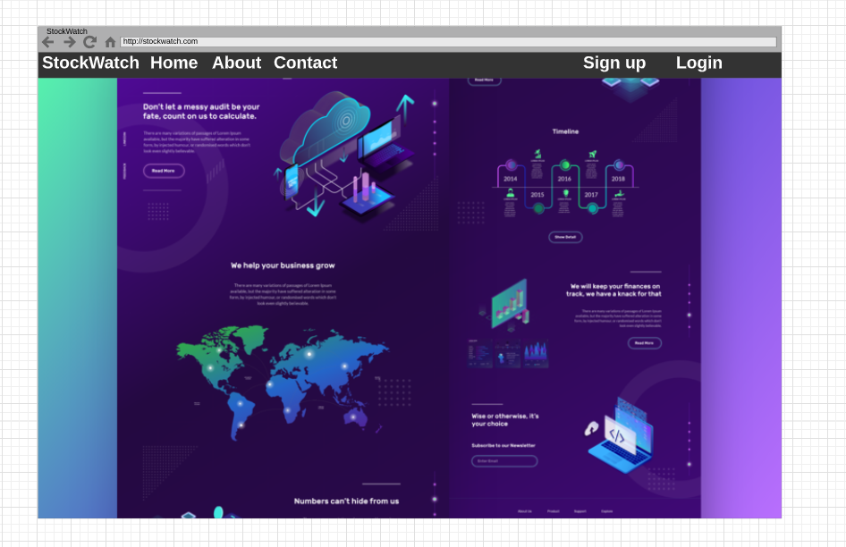

Slide 15
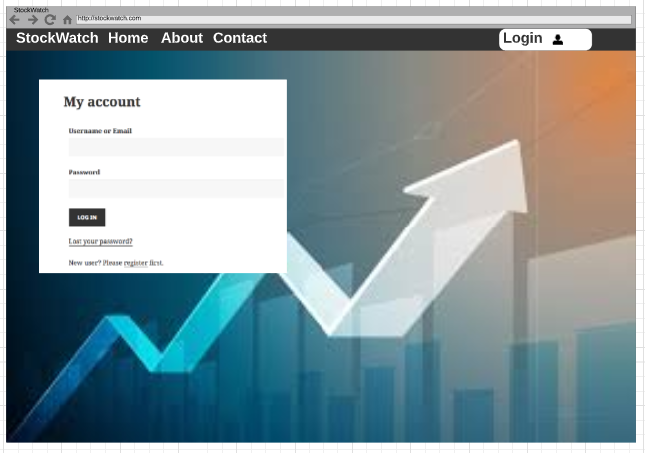

Slide 16
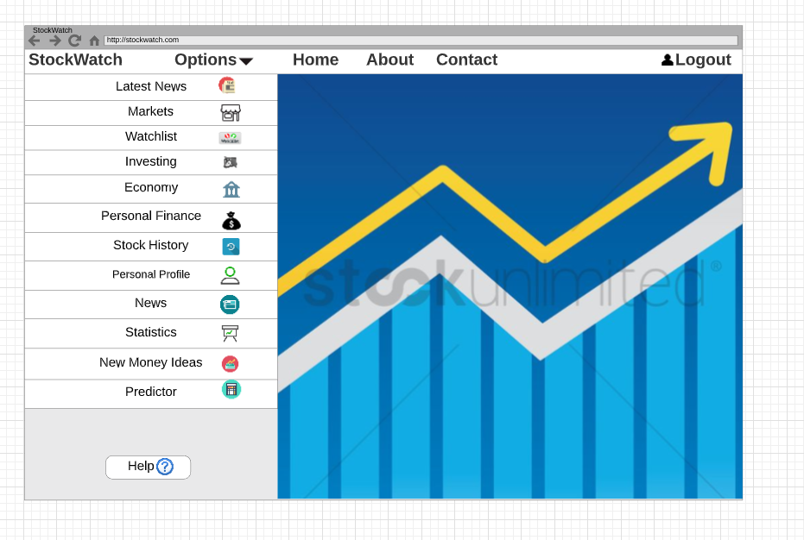

Slide 17

Questions?

